Slide 2
Aim
Back out trends in the prevalence of Rif Resistance over time using Xpert data in Sinan
Develop a relatively simple model that accounts for variation in roll-out of Xpert over time and across states, as well as potential bias in who is getting tested with Xpert

Slide 3
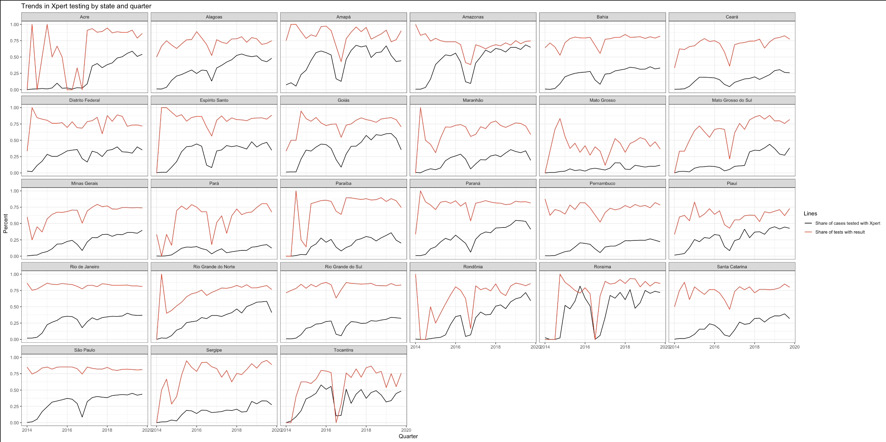
Setting the stage: Trends in Xpert testing overtime (2014-2019)
Notes:
- Upward trend in percent of cases , across most states though some flattening out
- On average, Xpert testing has reached XXX % of cases by 2019
- States with the highest performance:
- States with the lowest performance:

Slide 4
Model specification

